Slide 1
Protocols & Application

Slide 2
What is Protocol?
Protocol: In computer networks, communication occurs between entities in different systems. However, two entities can­ not simply send bit streams to each other and expect to be understood. For communication to occur, the entities must agree on a protocol. A protocol is a set of rules that govern data communications. A protocol defines what is communicated, how it is communicated, and when it is communicated.
Example: HTTP, FTP, TCP,IP etc.

Slide 3
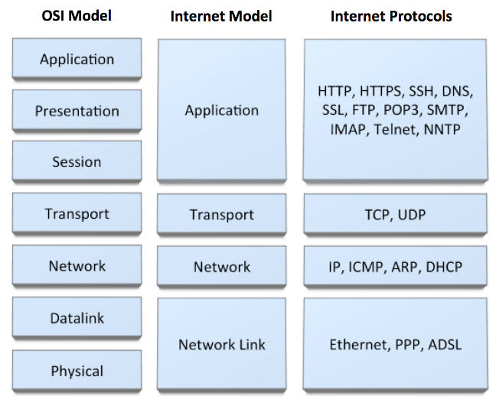
Different Layers Protocol

Slide 4
Protocol Types
PUSH protocol: In push protocols, the client opens a connection to the server and keeps it constantly active. The server will send (push) all new events to the client using that single always-on connection. In other words, the server PUSHes the new events to the client. Example: SMTP
PULL protocol: In pull protocols, the client periodically connects to the server, checks for and gets (pulls) recent events and then closes the connection and disconnects from the server. The client repeats this whole procedure to get updated about new events. In this mode, the clients periodically PULLs the new events from the server. Example: HTTP

Slide 5
Application Layer Protocol: HTTP
HTTP (Hypertext Transfer Protocol) is used across the world wide web (www) for data transfer and is one of the most used application protocols.
HTTP specifies a request/response protocol. When a client, typically a web browser, sends a request message to a server, the HTTP protocol defines the message types the client uses to request the web page and the message types the server uses to respond
The three common message types are:
■ GET
■ POST
■ PUT

Slide 6
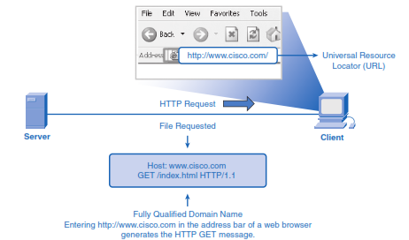
Application Layer Protocol: HTTP
GET: It is a client request for data. A web browser sends the GET message to request pages from a web server. As shown in Figure, when the server receives the GET request, it responds with a status line, such as HTTP/1.1 200 OK, and a message of its own, the body of which can be the requested file, an error message, or some other information.

Slide 7
Application Layer Protocol: HTTP
POST and PUT are used to send messages that upload data to the web server.
For example, when the user enters data into a form embedded in a web page, POST includes the data in the message sent to the server.
PUT uploads resources or content to the web server.

Slide 8
Application Layer Protocol: HTTP runs on TCP
The transfer protocol used throughout the World Wide Web is HTTP (Hyper Text Transfer Protocol). TCP provides a reliable data transfer service to HTTP, using TCP port 80. This implies that each HTTP request message emitted by a client process eventually arrives in tact at the server; similarly, each HTTP response message emitted by the server process eventually arrives in tact at the client. HTTP need not worry about lost data, or the details of how TCP recovers from loss or reordering of data within the network. That is the job of TCP and the protocols in the lower layers of the protocol stack

Slide 9
Application Layer Protocol: FTP
FTP is another commonly used application layer protocol. FTP was developed to allow file transfers between a client and a server. An FTP client is an application that runs on a computer that is used to push and pull files from a server running the FTP daemon (FTPd).
To successfully transfer files, FTP requires two connections between the client and the server: one for commands and replies, and the other for the actual file transfer.
The client establishes the first connection to the server on TCP port 21. This connection is used for control traffic, consisting of client commands and server replies.
The client establishes the second connection to the server over TCP port 20. This connection is for the actual file transfer and is created every time a file is transferred.
The file transfer can happen in either direction, as shown in Figure. The client can download (pull) a file from the server or upload (push) a file to the server.

Slide 10
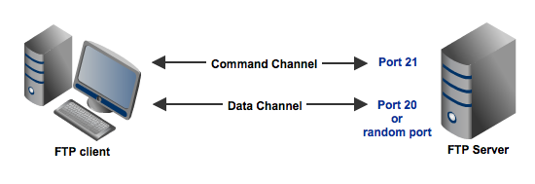
Application Layer Protocol: FTP

Slide 11
Application Layer Protocol: DNS
Domain Name Service (DNS):
DNS provides a core Internet function, translating hostnames to their underlying IP addresses, for user applications and other software in the Internet. The DNS protocol defines an automated service that matches resource names with the required numeric network address
DNS uses a large number of name servers, organized in a hierarchical fashion and distributed around the world. No one name server has all of the mappings for all of the hosts in the internet. Instead, the mappings are distributed across the name servers. There are three types of name servers:
Root name servers
Local name server
Authoritative name servers

Slide 12
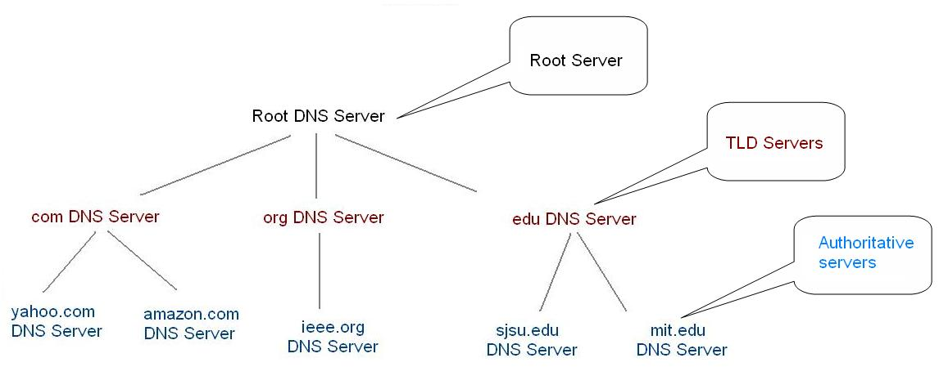
DNS Hierarchy

Slide 13
DNS cont.
Root name servers: A root server contains information about the root and top-level domains, When a local name server cannot immediately satisfy a query from a host (because it does not have a record for the hostname being requested), the local name server behaves as a DNS client and queries one of the root name servers.
Local name server: Each ISP - such as a university, an academic department, an employee's company or a residential ISP - has a local name server (also called a default name server). When a host issues a DNS query message, the message is first sent to the host's local name server. The IP address of the local name server is typically configured by hand in a host.
Authoritative name servers: Every host is registered with an authoritative name server. Typically, the authoritative name server for a host is a name server in the host's local ISP. Many name servers act as both local and authoritative name servers.

Slide 14
Internet Domain Names
As an example, consider a namespace with names of the form:
local. site
where site is the site name authorized by the central authority, local is the part of a name controlled by the site, and (".") is a delimiter used to separate them.
adding a group subdivision to names already partitioned by site produces the following name syntax:
local. group. site

Slide 15
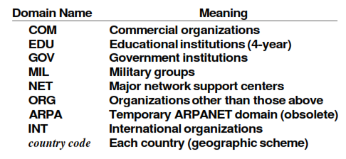
Internet Domain Names
Example: cs .purdue . edu
contains three labels: cs, purdue, and edu. Any suffix of a label in a domain name is also called a domain. In the above example the lowest level domain is cs .purdue. edu, (the domain name for the Computer Science Department at Purdue University), the second level domain is purdue. edu (the domain name for Purdue University), and the top-level domain is edu (the domain name for educational institutions). As the example shows, domain names are written with the local label first and the top domain last.

Slide 16
DNS: How it works? Example: Hannah want to connect at www.fredsco.com
Hannah opens a browser, types in www.fredsco.com, and sends a DNS resolution request to her DNS (example.com).
example.com's DNS doesn't know the name http://www.fredsco.com. However, the DNS now has some configuration that tells it that if it doesn't know the name, it should ask the DNS server at IP address 1.1.1.1 (Root server).
The DNS server at 1.1.1.1 has a table that lists the IP addresses of a bunch of name servers. DNS server 1.1.1.1 knows that for all names that end in “example.com,“ DNS 150.1.3.4 can resolve the names. It also knows that for all names that end in "fredsco.com," DNS 199.1.1.3 can resolve the names. Finally, DNS server 1.1.1.1 can direct each request to the right name server. This DNS sends a message back to the example.com DNS, referring it to the DNS at 199.1.1.3.

Slide 17
DNS: How it works?
The example.com DNS repeats the name resolution request, now sending the request to the DNS server at Fredsco (199.1.1.3).
The Fredsco DNS gets the request, and it knows the name and IP address. It sends a reply to the requesting host, namely, example.com's DNS server.
Finally, the example.com DNS server replies to Hannah, telling her that www.fredsco.com resolves to IP address 199.1.1.2.

Slide 18
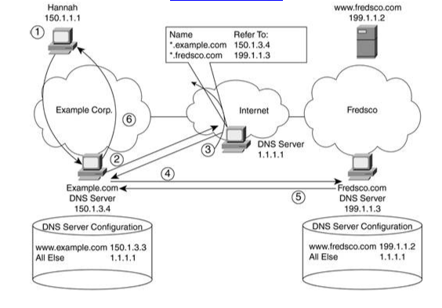
DNS: How it works?

Slide 19
Different types of DNS queries
DNS queries can be classified according the manner in which a complete request is processed. Generally queries can be classified as follows.
Recursive query: A recursive query is a kind of query, in which the DNS server, who received the sender’s query will do all the job of fetching the answer, and giving it back to the sender. During this process, the DNS server might also query other DNS server's in the internet of the sender’s behalf, for the answer.
Iterative query OR Nonrecursive query: In an iterative query, the name server, will not go and fetch the complete answer for the sender’s query, but will give back a referral to other DNS server's, which might have the answer.

Slide 20
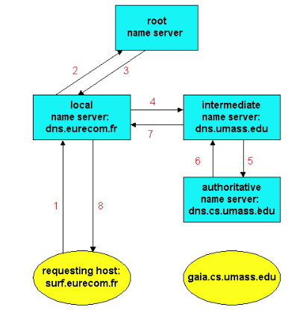
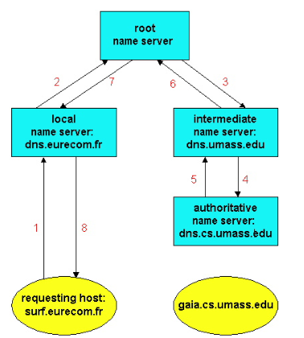
Recursive query/ Iterative query
Fig: A query chain with iterative queries. Fig: A query chain with recursive queries.

Slide 21
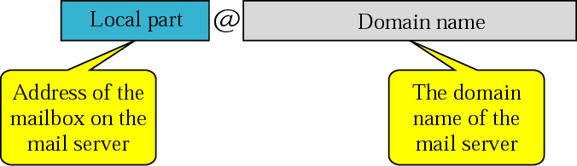
Electronic Mail in the Internet
Along with the Web, electronic mail is one of the most popular Internet applications. Just like ordinary "snail mail," email is asynchronous -- people send and read messages when it is convenient for them, without having to coordinate with other peoples' schedules.
In contrast with snail mail (paper mail), electronic mail is fast, easy to distribute, and inexpensive. Moreover, modern electronic mail messages can include hyperlinks, HTML formatted text, images, sound and even video.

Slide 22
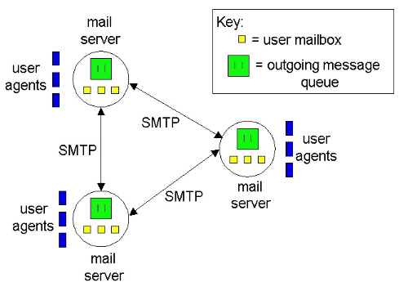
Major components of Internet Mail System
User agents
Mail servers
Simple Mail Transfer Protocol (SMTP)

Slide 23
SMTP
The Simple Mail Transfer Protocol (SMTP) is the principle application-layer protocol for Internet electronic mail. It uses the reliable data transfer service of TCP (port 25) to transfer mail from the sender's mail server to the recipient's mail server.
SMTP has two sides:
Client side; which executes on the sender's mail server
Server side; which executes on the recipient's mail server

Slide 24
Working principle of SMTP
Suppose Alice wants to send Bob a simple ASCII message:
Alice invokes her user agent for email, provides Bob's email address (e.g., bob@someschool.edu), composes a message and instructs the user agent to send the message.
Alice's user agent sends the message her mail server, where it is placed in a message queue.
The client side of SMTP, running on Alice's mail server, sees the message in the message queue. It opens a TCP connection to a SMTP server, running on Bob's mail server.
After some initial SMTP handshaking, the SMTP client sends Alice's message into the TCP connection.
At Bob's mail server host, the server side of SMTP receives the message. Bob's mail server then places the message in Bob's mailbox.
Bob invokes his user agent to read the message at his convenience

Slide 25
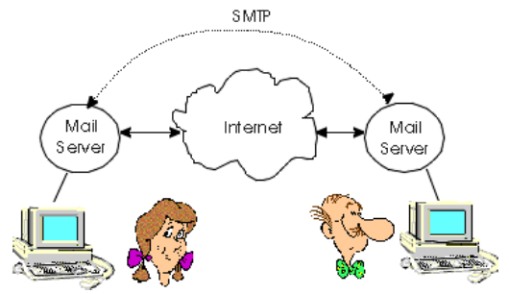
Working principle of SMTP
Fig: Alice's mail server transfers Alice's message to Bob's mail server

Slide 26
Introduction of POP3/IMAP
Puzzle in SMTP: How does a recipient like Bob, running a user agent on his local PC, obtain his messages, which are sitting on a mail server within Bob's ISP?
Solution: Introducing a special access protocol that transfers the messages from Bob's mail server to the local PC.
POP3 (Post Office Protocol - Version 3)
IMAP (Internet Mail Access Protocol)
SMTP is used to transfer mail from the sender's mail server to the recipient's mail server; SMTP is also used to transfer mail from the sender's user agent to the sender's mail server.
POP3 or IMAP are used to transfer mail from the recipient's mail server to the recipient's user agent.

Slide 27
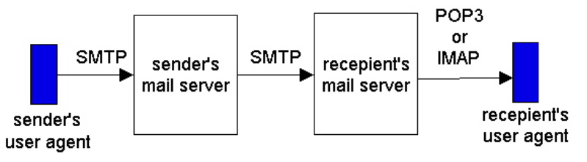
Introduction of POP3/IMAP cont.
Fig: E-mail protocols and their communicating entities.

Slide 28
POP3 (Post Office Protocol - Version 3)
POP3 is an extremely simple mail access protocol. Because the protocol is so simple, its functionality is rather limited.
POP3 begins when the user agent (the client) opens a TCP connection to the mail server (the server) on port 110. With the TCP connection established, POP3 progresses through three phases:
authorization,
transaction
update.
During the first phase, authorization, the user agent sends a user name and a password to authenticate the user downloading the mail.
During the second phase, transaction, the user agent retrieves messages. During the transaction phase, the user agent can also mark messages for deletion, remove deletion marks, and obtain mail statistics.
The third phase, update, occurs after the client has issued the quit command ending the POP3 session; at this time, the mail server deletes the messages that were marked for deletion.

Slide 29
IMAP
IMAP is an Internet Message Access Protocol. It is a method of accessing electronic mail messages that are kept on a possibly shared mail server. In other words, it permits a "client" email program to access remote message stores as if they were local.
For example, email stored on an IMAP server can be manipulated from a desktop computer at home, a workstation at the office, and a notebook computer while travelling, without the need to transfer messages or files back and forth between these computers. IMAP uses TCP/IP port 143.

Slide 30
TELNET
TELNET: It is a client/server application program. TELNET stands for TErminaL NETwork. It is the standard TCP/IP protocol for virtual terminal service as proposed by the International Organization for Standards (ISO).
TELNET enables the establishment of a connection to a remote system in such a way that the local terminal appears to be a terminal at the remote system.

Slide 31
TELNET: How it works?
When a user wants to access an application program or utility located on a remote machine, he/she performs remote log-in. Here the TELNET client and server programs come into use.
The user sends the keystrokes to the terminal driver, where the local operating system accepts the characters but does not interpret them. The characters are sent to the TELNET client, which transforms the characters to a universal character set called network virtual terminal (NVT) characters and delivers them to the local TCP/IP protocol stack.
At the remote terminal, a software called a pseudoterminal driver which pretends that the characters are coming from a terminal. The operating system then passes the characters to the appropriate appli­cation program.

Slide 32
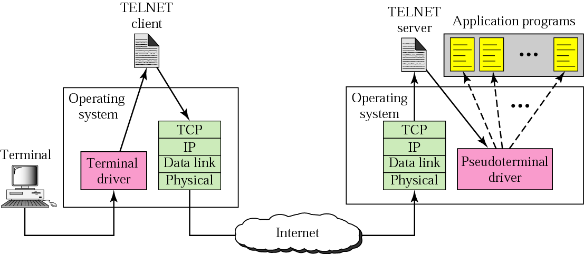
TELNET

